Slide 1

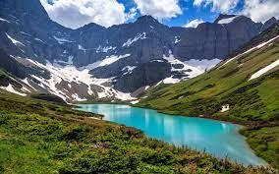
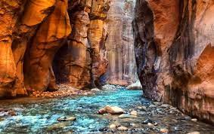
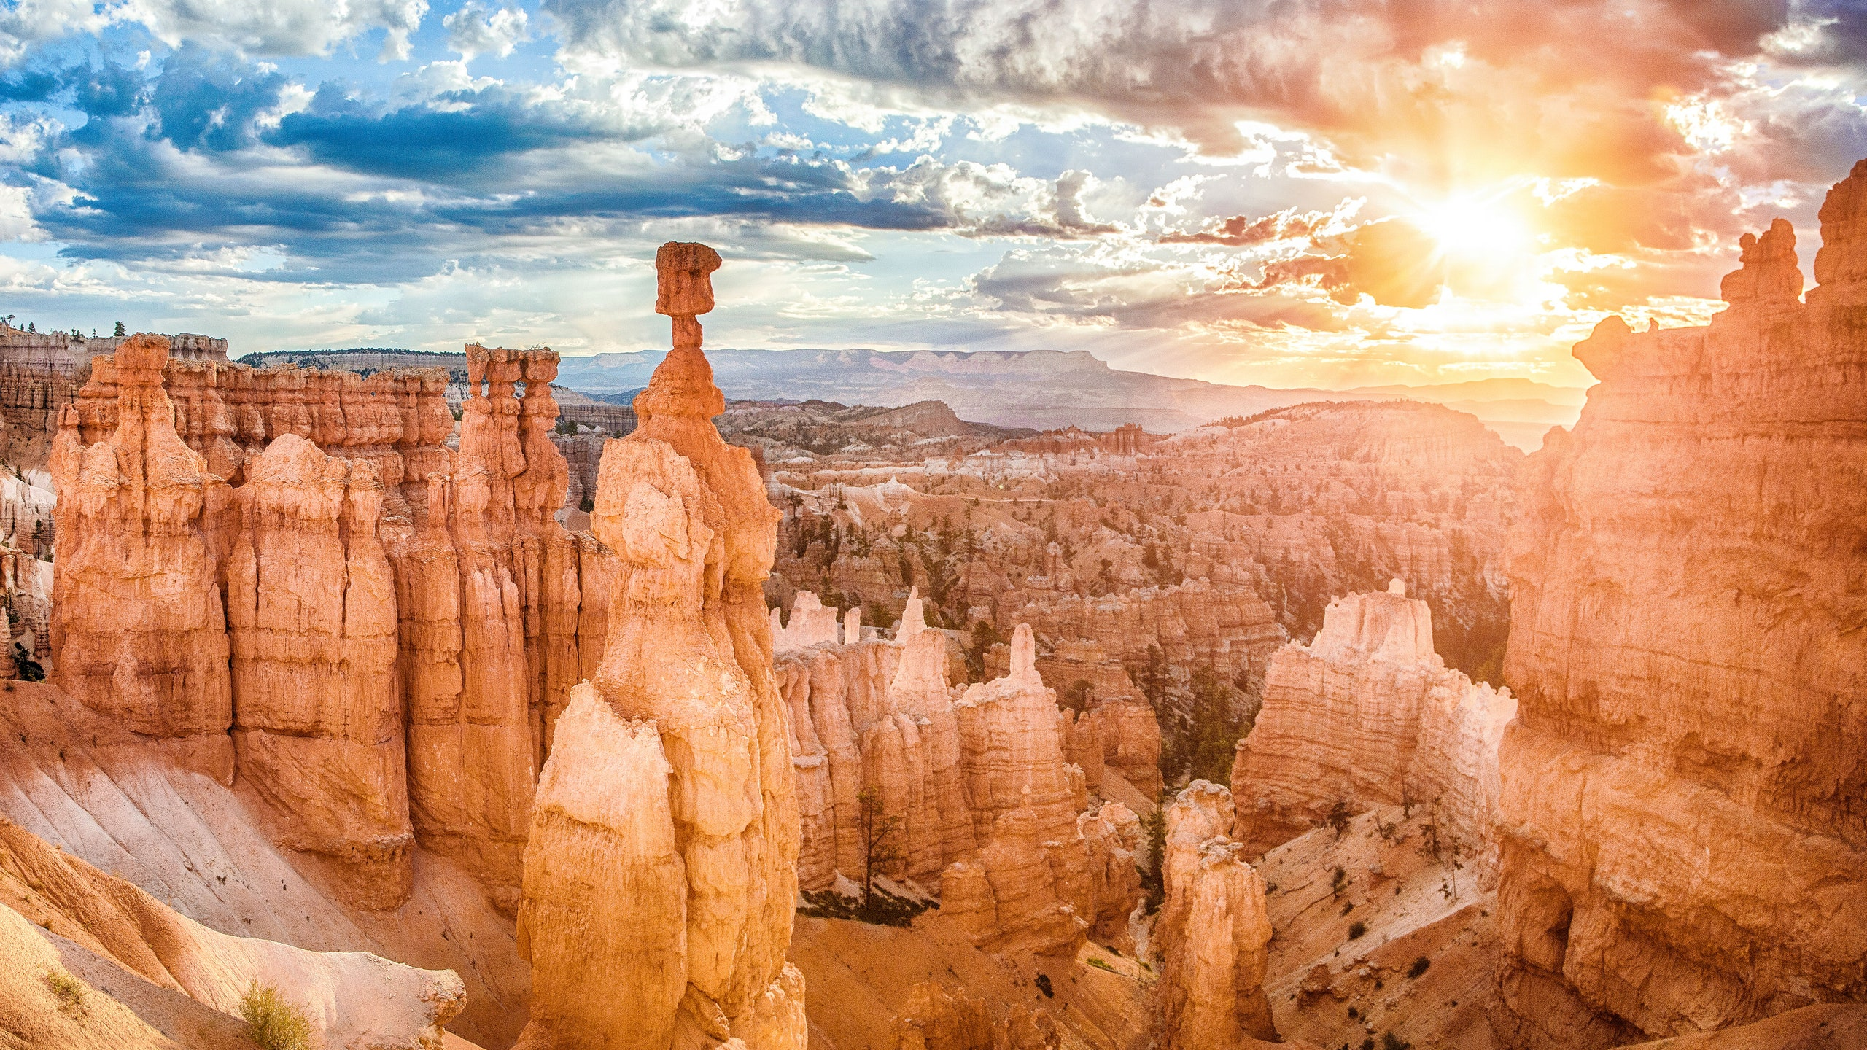
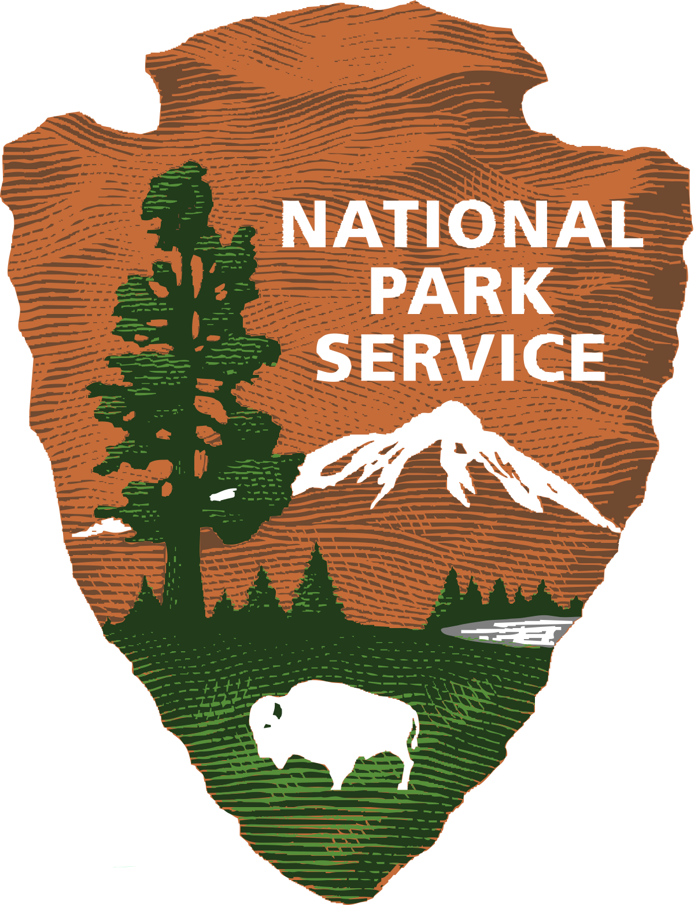
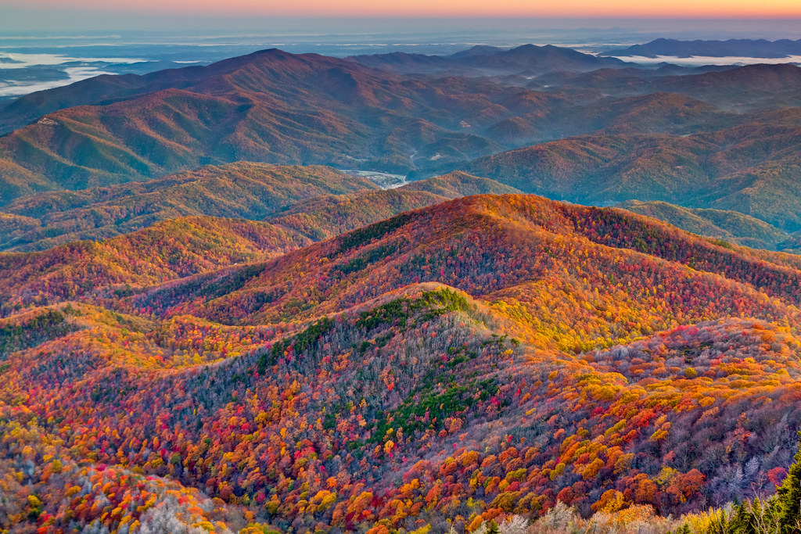
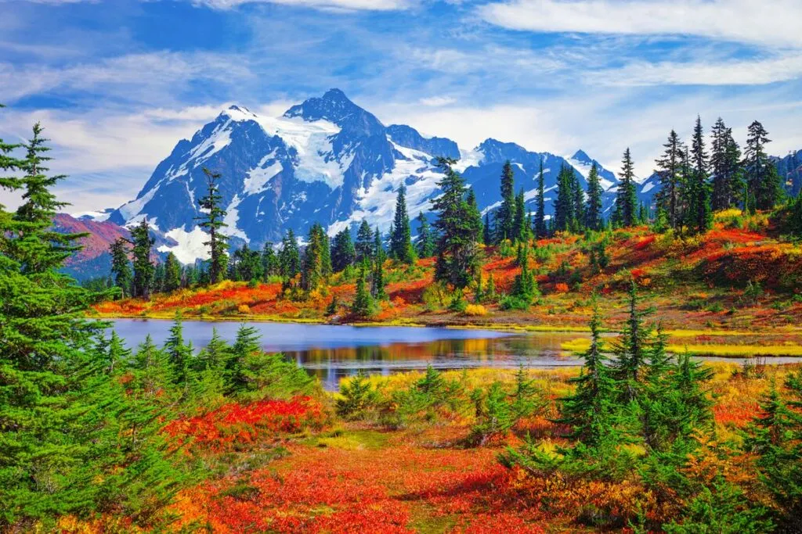
National Park Service Chatbot
Betzalel Moskowitz

Slide 2
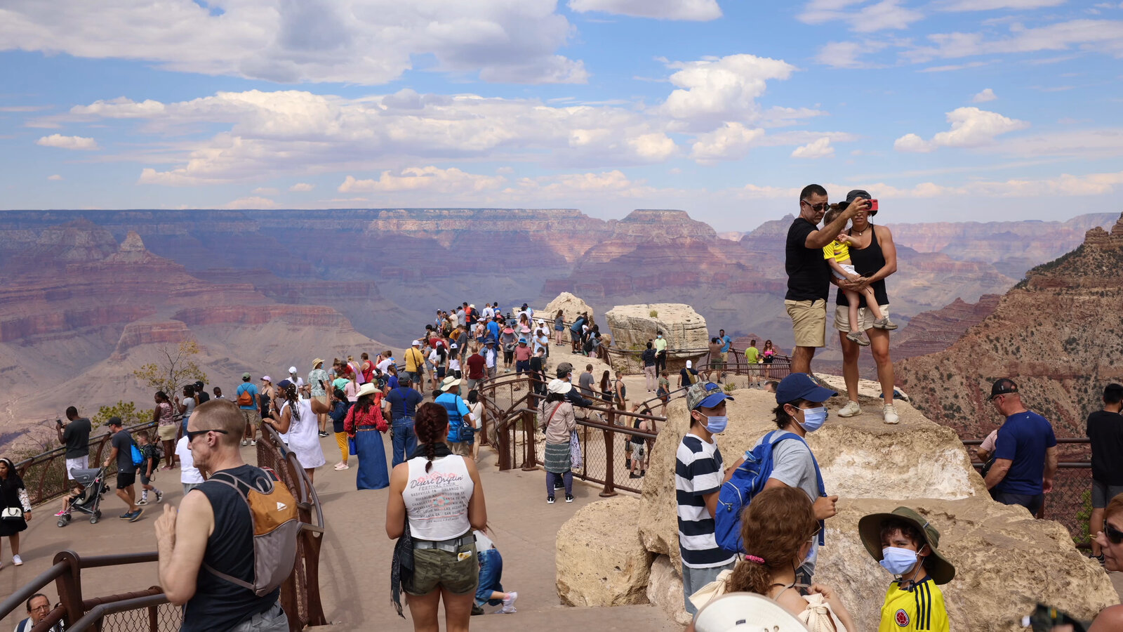
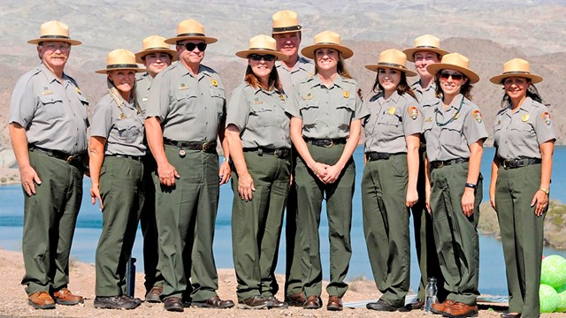
Business Context
20% increase in national park visitation over the last decade¹
16% loss of employees during same period due to insufficient federal funding¹
Lack of available staff posing major challenge as parks become overwhelmed with visitors¹
National Park Service (NPS) would benefit from a chatbot to help answer questions and provide recommendations for visitors and enthusiasts

Slide 3
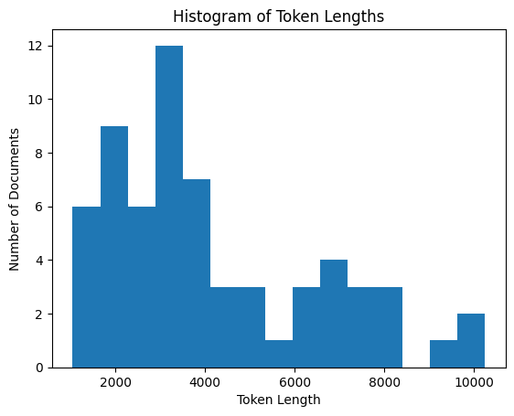
Problem Definition
The ideal NPS Chatbot responses should be:
Accurate
Helpful
Contextual
Synthesized from multiple sources (if necessary)
Fast
Inexpensive
Challenges
Splitting up documents into smaller chunks hinders ability to collect contextual information
Lack of available labeled data limits ability to fine-tune pre-trained models
Data
Web-scraped from 63 Wikipedia articles about US National Parks
Long documents (> 1k tokens)

Slide 4
Methods
Quality Assessment Criteria
Chatbot Architectures
Five questions were designed to assess chatbot performance in the following areas:
Information extraction
“When was Yellowstone National Park established?”
Understanding context
“What factors make the Grand Canyon unique?”
Providing a range of information
“What activities are available in Shenandoah National Park?”
Retrieving relevant information across multiple documents
“Which national parks are located in California?”
Generative ability
“Explain the potential effects of climate change on Glacier National Park's glaciers and ecosystems. How can the park adapt to these changes?”
TF-IDF Sentences Cosine Similarity²
Sentence Transformer Cosine Similarity
Transformers Pipeline (Question-Answering)
T5 Abstractive Question Answering
OpenAI GPT³

Slide 5
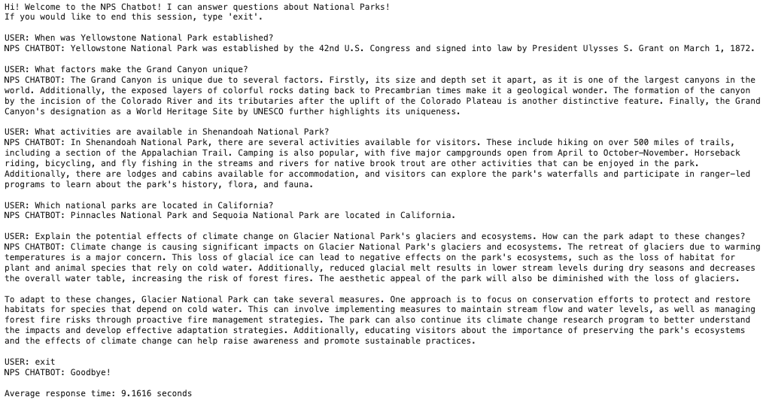
Results – OpenAI GPT Chatbot

Slide 6
Recommendations
Best Chatbot = OpenAI GPT
Pros:
Superior performance in all criteria areas
Human-like and helpful responses
Mentions if context is not available for specific information
Responds relatively quickly
Cons:
Costs about $0.01 per query
Further Areas for Exploration
Fine-tune models
Will require labeled datasets
Collect more data from other websites to augment chatbot capabilities
Dynamic Content Updates
Integrate user feedback loop to remember information provided by user during session

Slide 7
References
Bennett, G. (2022, April 20). National parks are swamped, but the park servicefaces mountainous employment crises. OnLabor. https://onlabor.org/national-parks-are swamped-but-the-park-service-faces-mountainous-employment-crises/
Dass, R. (2018, September 24). Create your chatbot using python NLTK. Medium. https://medium.com/@ritidass29/create-your-chatbot-using-python-nltk- 88809fa621d1
Hafiz, I. (2023, April 3). Creating your own AI-powered Second Brain: A Guide with Python and CHATGPT. Medium. https://levelup.gitconnected.com/creating-your- own-ai-powered-second-brain-a-guide-with-python-and-chatgpt-f5547ef7e136

Slide 8
Photo References
https://www.travelandleisure.com/thmb/gLG2qcu2Dib79P1r82PggovA-KI=/750x0/filters:no_upscale():max_bytes(150000):strip_icc():format(webp)/glacier-national-park-NATPARKS0619-30921de01ce044fcbfd80c5dbcd99d1d.jpg
https://media.tacdn.com/media/attractions-splice-spp-674x446/0b/d0/15/48.jpg
https://www.sunset.com/wp-content/uploads/Bryce-Canyon-National-Park-hoodoos-1200x600.jpg
https://www.traveloffpath.com/wp-content/uploads/2022/02/lesser-known-national-parks-735x490.jpg.webp
https://littlevalleymountainresort.com/application/files/2016/5643/6911/smokymountains.jpg
https://upload.wikimedia.org/wikipedia/commons/1/1d/US-NationalParkService-Logo.svg
https://static01.nyt.com/images/2021/07/08/travel/09travel-parks-promo/08travel-parks-top-still-videoSixteenByNineJumbo1600.jpg
https://www.nps.gov/common/uploads/grid_builder/military/crop16_9/2681F8BB-1DD8-B71B-0BFFF5DE46797779.jpg?width=640&quality=90&mode=crop

